Slide 1
ECE/CS 552: Parallel Processors
Boone Severson
Lecture notes based in part on slides created by Joshua San Miguel, Mikko Lipasti, Mark Hill, David Wood, Guri Sohi, John Shen and Jim Smith

Slide 2
Multithreading
context-switching
simultaneous multithreading
chip multiprocessor
parallelism/throughput
area/complexity

Slide 3



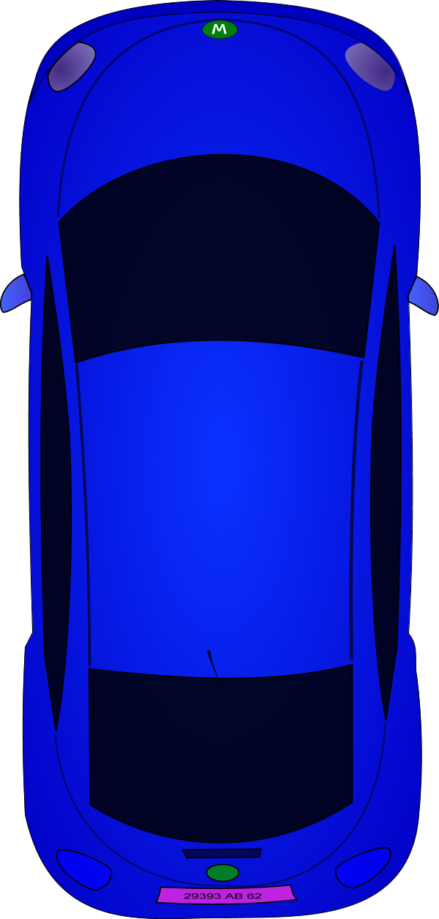
Multithreading
convoying
self-navigating
separate roads

Slide 4

MIPS R10K
Reorder Buffer
RS
PC
Fetch
Decode
Dispatch
Issue
Execute
Complete
Retire
RS
RS
Physical
Register File
Map Table
& Free List

Slide 5
Multithreading
Reorder Buffer
PC
RS
PC
Fetch
Decode
Dispatch
Issue
Execute
Complete
Retire
RS
PC
RS
PC
Physical
Register File
Map Table
Map Table
Map Table
Map Table
Free List

